Slide 1
MTA Traffic Analysis for Esport Team Cheetah
Crystal Han

Slide 2
Introduction
Esports team Cheetah is holding a gaming event in March and hopes to invite as many interested gamers, working professionals, and students as possible.
Cheetah team intends to place electronics advertisements at specific NYC subway stations to promote their event to gamers, working professionals, students, and anyone else interested
Agenda: analyze MTA subway data on traffic flow to optimize placement and time of the advertisement to maximize awareness to target demographics: gamers, working professionals, and students

Slide 3
Methodology
Data
MTA Turnstiles Data (MTA)
Additional Data: Colleges and Universities near NYC subway stations, OpenStreetMap
Tools:
Python, Pandas, Numpy, SQLAlchemy
Matplotlib, Seaborn, geopandas/geoplot, folium
Github

Slide 4
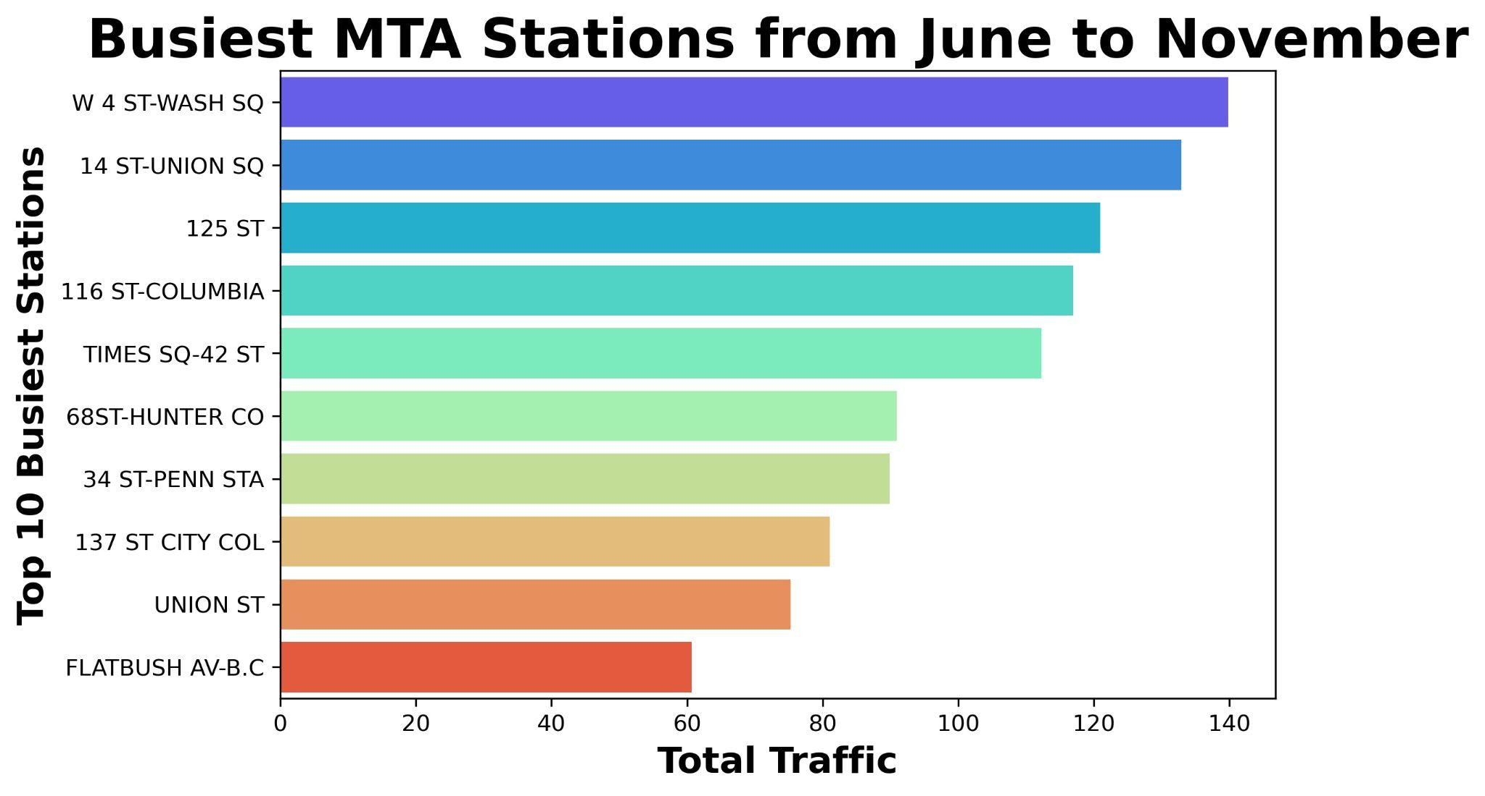
Top 10 Busiest Stations near target demographics

Slide 5
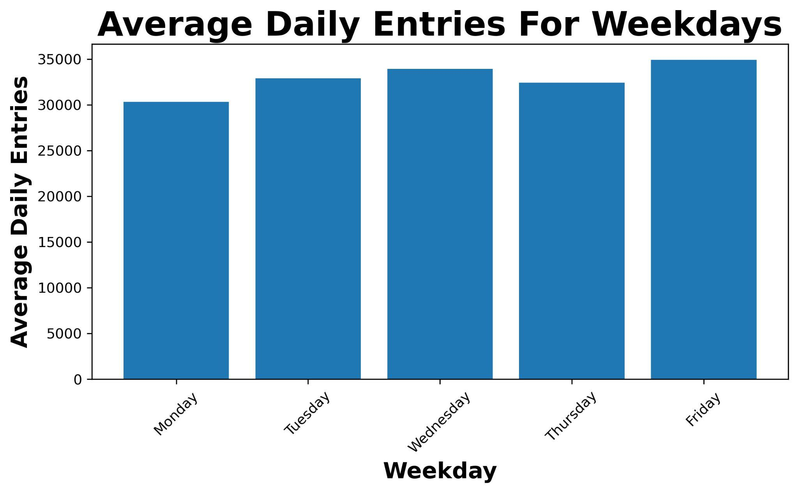
Average Daily Entries of Weekdays

Slide 6
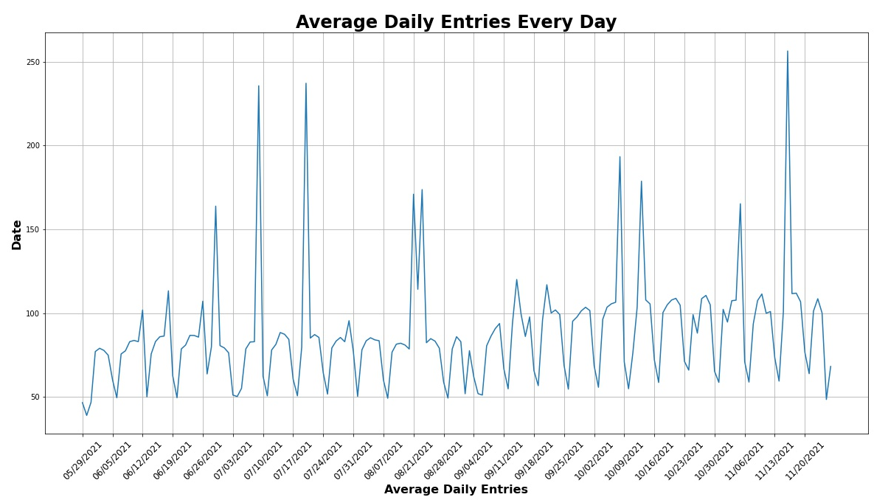
Average Daily Entries for Every Day

Slide 7
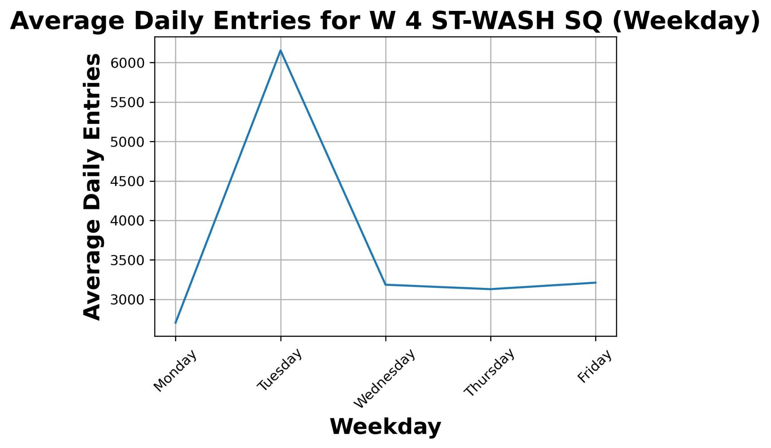
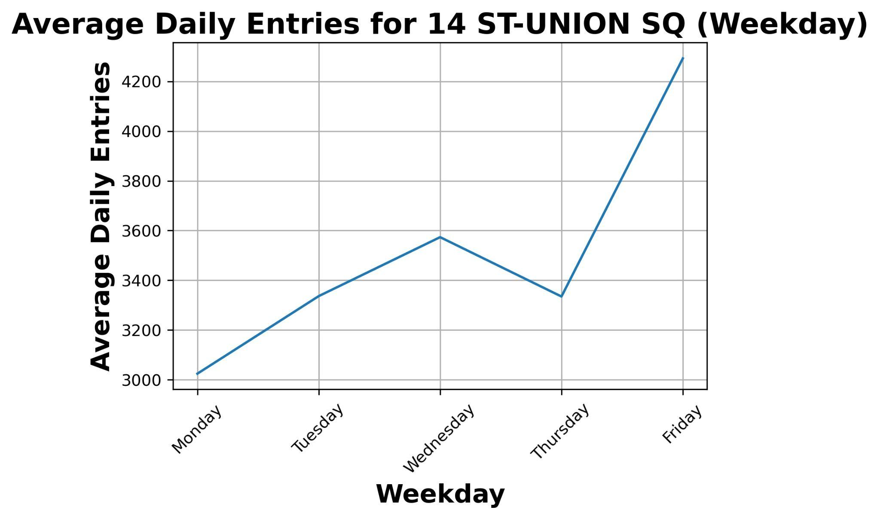
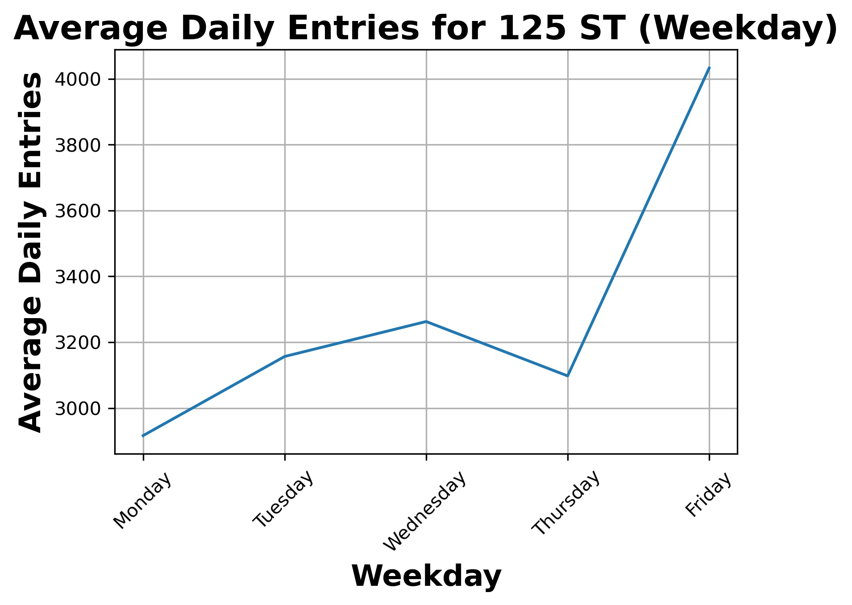
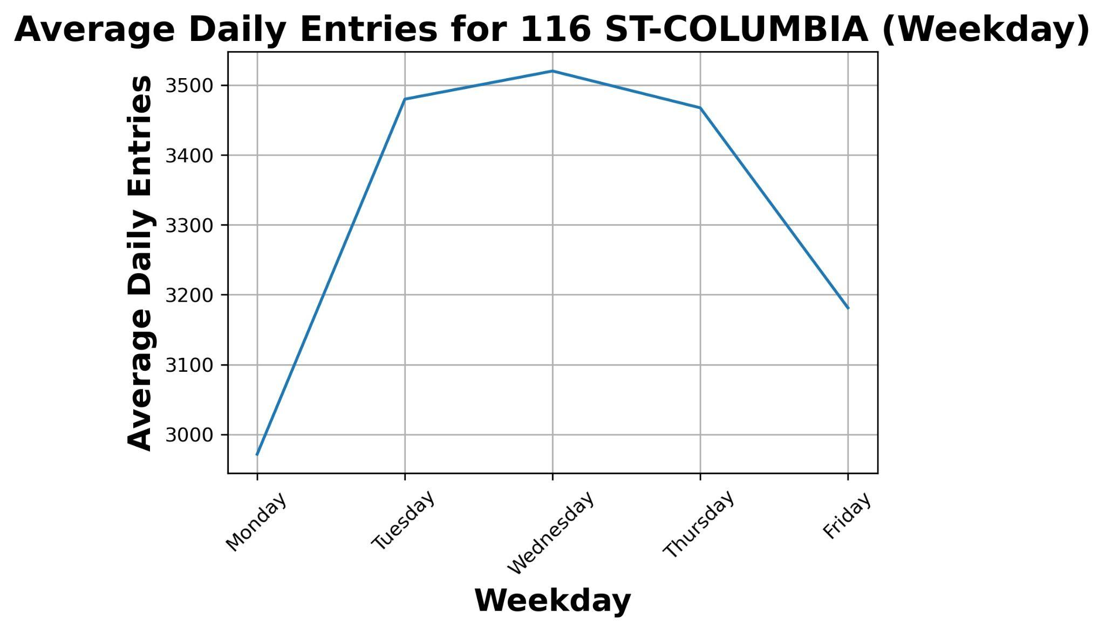
Average Daily Entries for Top 5 Stations

Slide 8
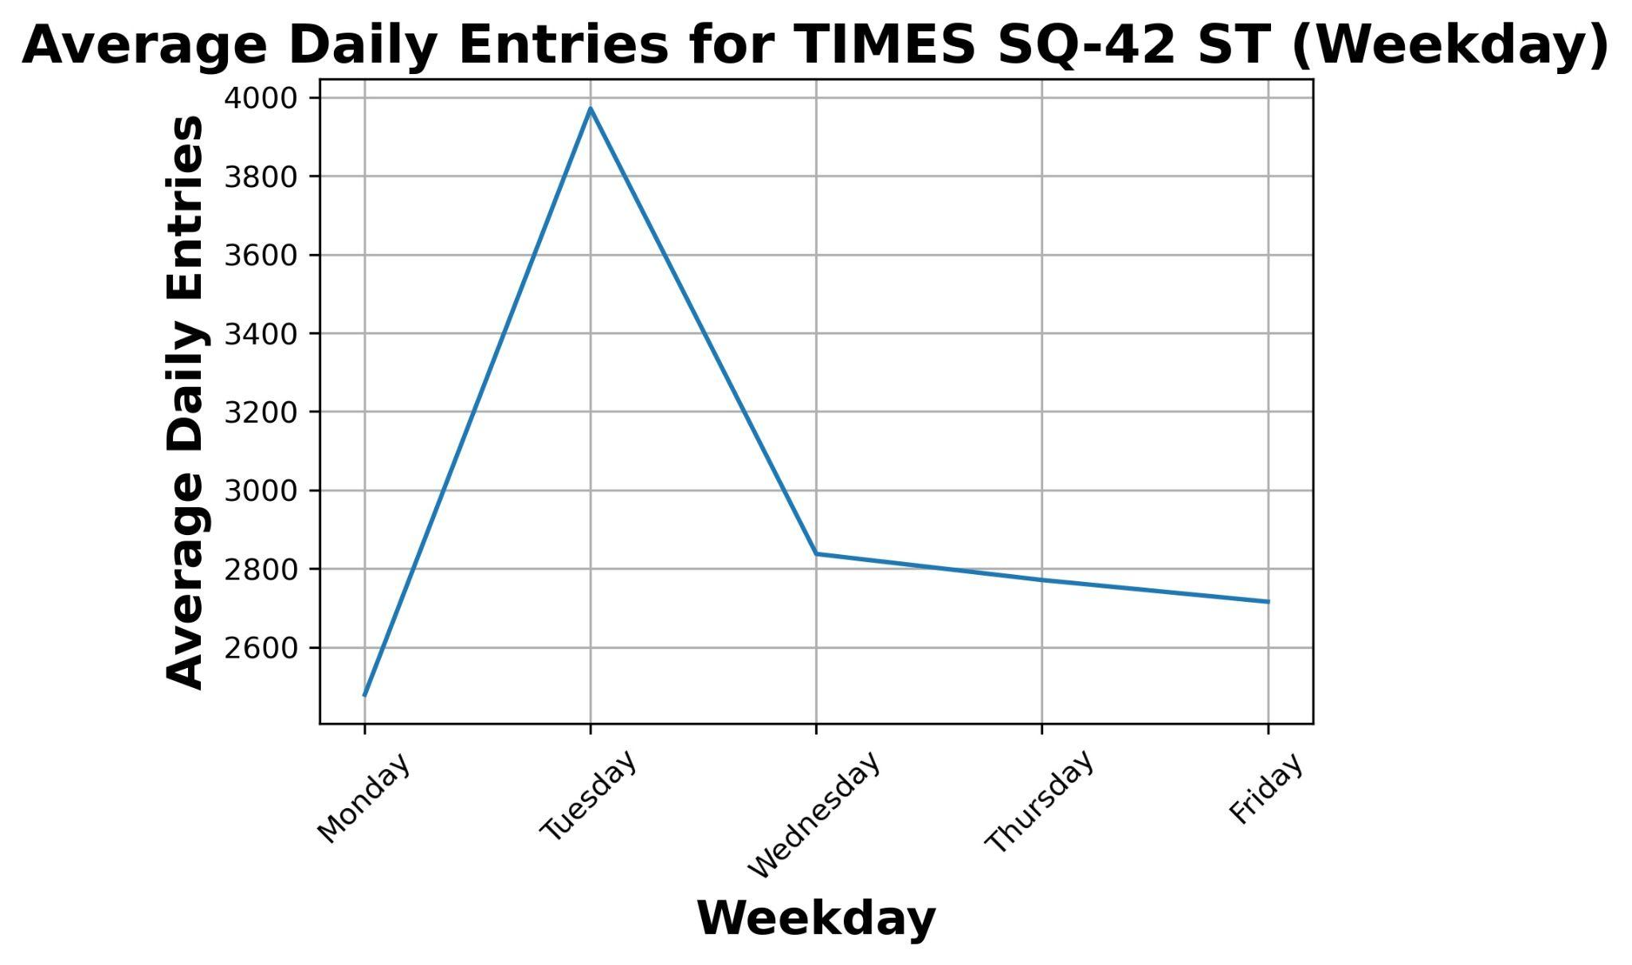
Average Daily Entries for Top 5 Stations

Slide 9
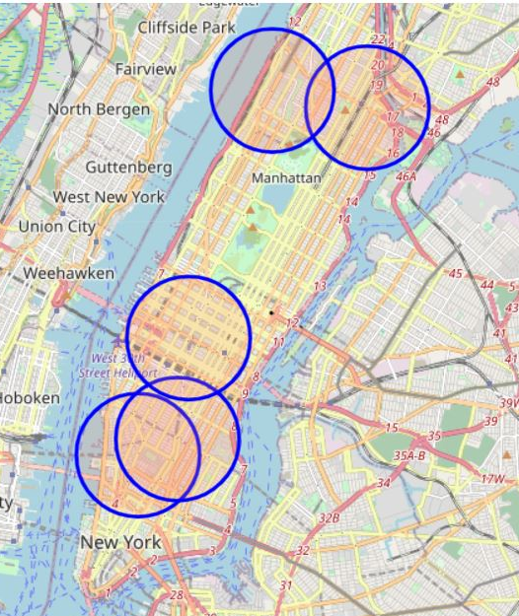
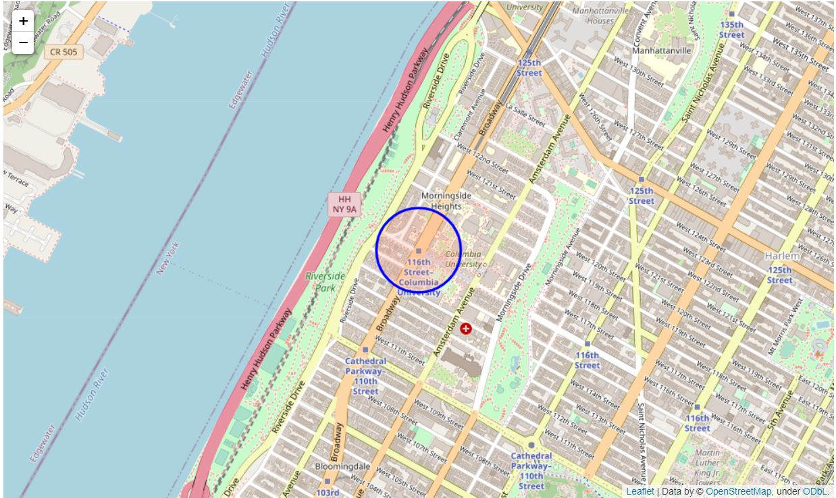
Geographical Map of Top Stations

Slide 10
Conclusion
Top stations close to universities and working professionals
Put electronic advertisements in these stations:
W 4 ST -WASH SQ
14 ST-UNION SQ
125 ST
116 ST-COLUMBIA
TIMES SQ-42 ST
During Mondays, Tuesdays, and Fridays

Slide 11
Future Work
Plotting location of tech companies and universities
Proximity of stations and tech companies and universities
Weekend commutes vs Weekday commutes
Compare top stations and possible demographic targets as well as number of tech companies and universities located near the station

Slide 12
Appendix
Time period: June to November
Data cleaning: Fixing some outliers that do not present normal daily traffic behavior within a week (weekdays specific)
Reason for selecting the stations:
Proximity to working professionals and universities
Outliers-tourism

Slide 13
Thank you

